Slide 1














Exploration Driven Growth
-Likitha Rayala

Slide 2
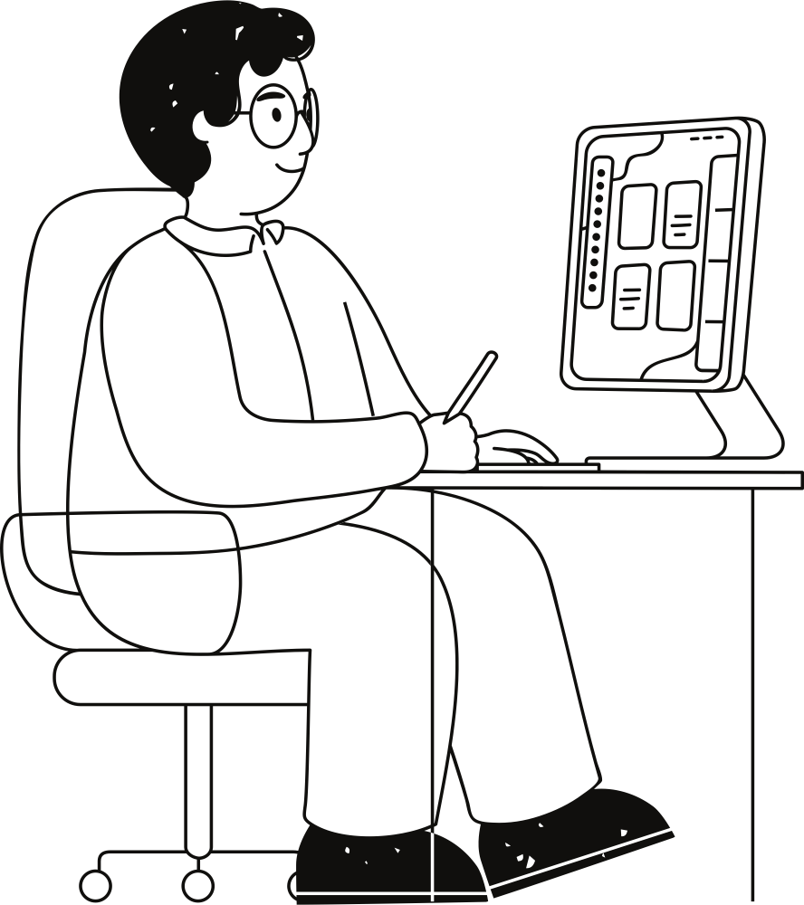
What is My Passion ?
•⁠ ⁠Curiosity to explore new things
•⁠ ⁠Learning from every experience
•⁠ ⁠Growing through experimentation

Slide 3
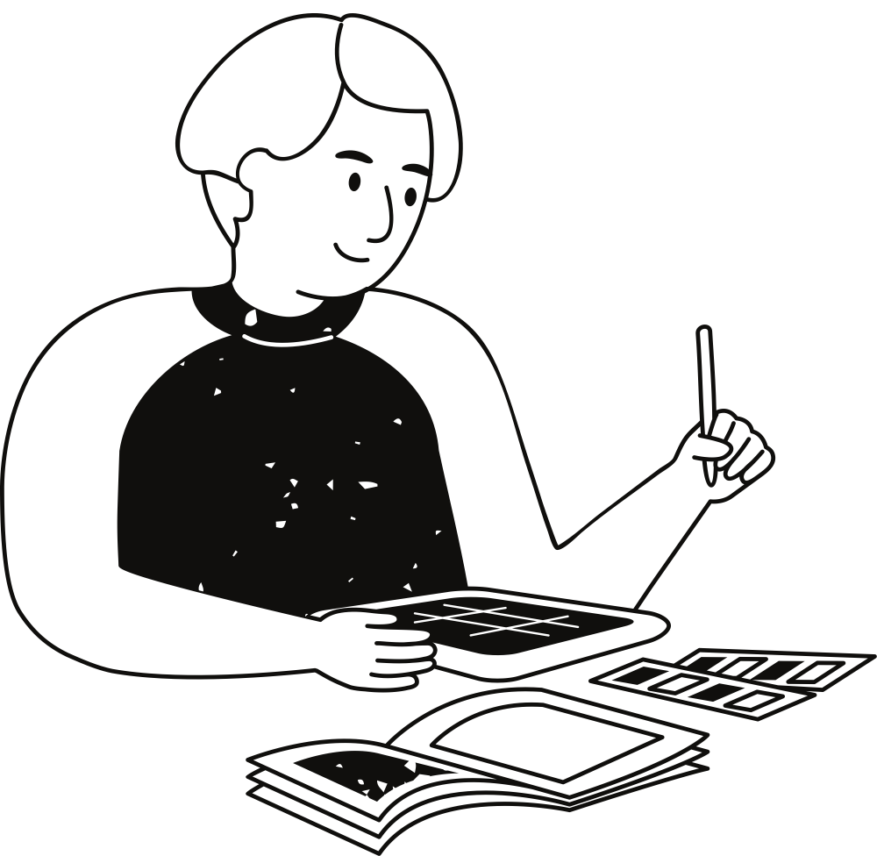
How It Started
•⁠ ⁠I always liked trying new things
•⁠ ⁠Small experiences shaped my curiosity
•⁠ ⁠Exploration helped me learn more
about myself

Slide 4
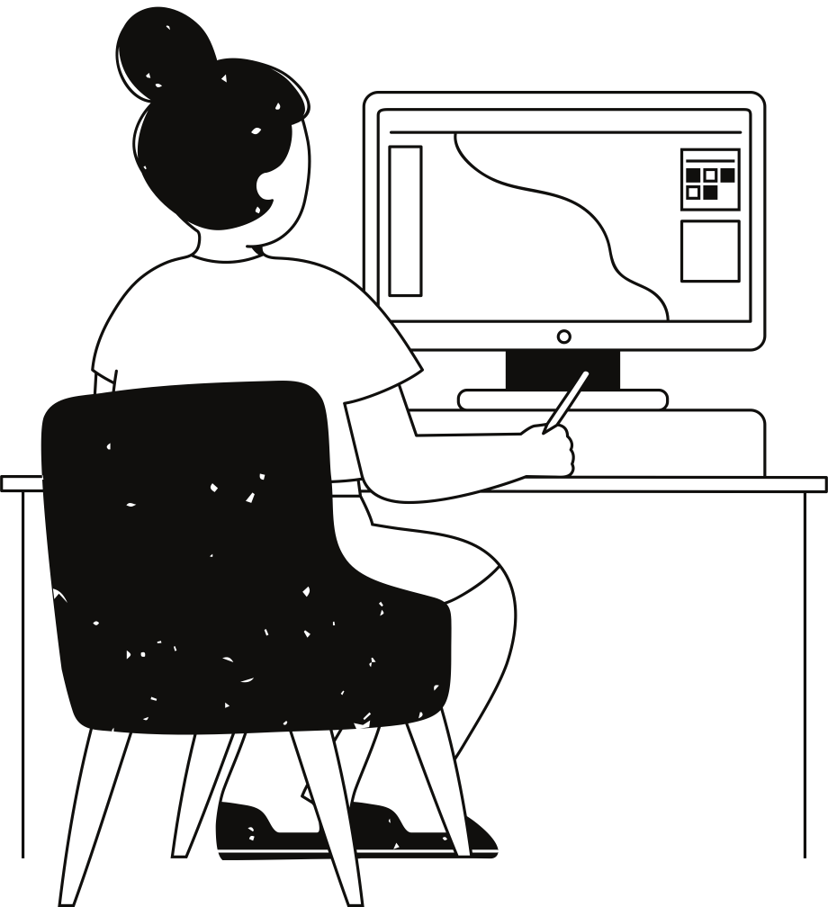
What I Learned Through Exploration
•⁠ ⁠Adaptability
•⁠ ⁠Confidence
•⁠ ⁠New skills
•⁠ ⁠Understanding my interests

Slide 5
Thank you !

